Slide 1


Bar Crawl Optimization Team 1

Slide 2


Agenda
the situation
objective
solution framework
demo
under the hood
constraints
results
additional applications
questions

Slide 3





The Situation
Team 1 Reunion?
Great idea! Where should we go?
LET’S GO TO CANADA!
I heard Toronto has great breweries
TEAM 1 BAR CRAWL!
YES. I’ll start planning the crawl!

Slide 4
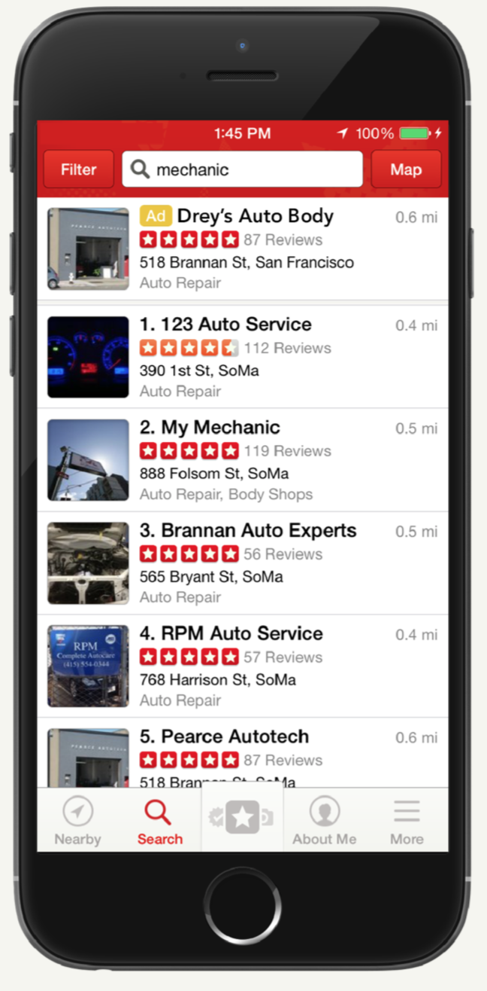
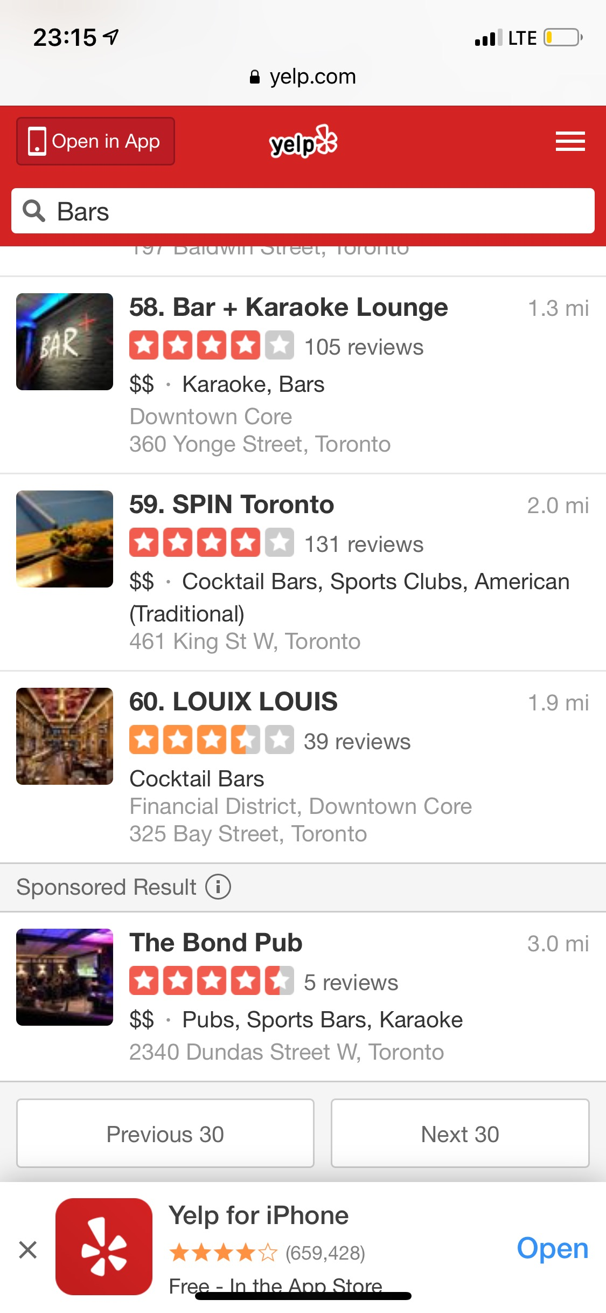
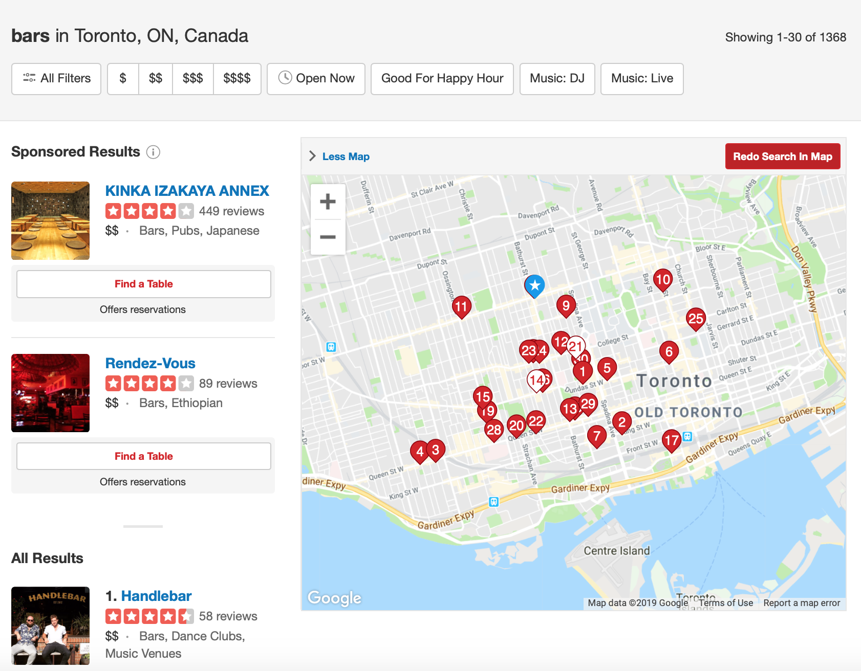
The Situation
Just checked Yelp.
Toronto has >1.3K bars…
I already love Toronto.
Showing 31-60 of 1386
bars
Agreed, but how do we choose where to go?
OPTIMIZATION
Yelp has a dataset we can use.

Slide 5


Objective
maximize rating
minimize walking
minimize waiting
maximize fun

Slide 6
Solution Framework
Develop Linear Program
Create User Interface
Pre-process data

Slide 7
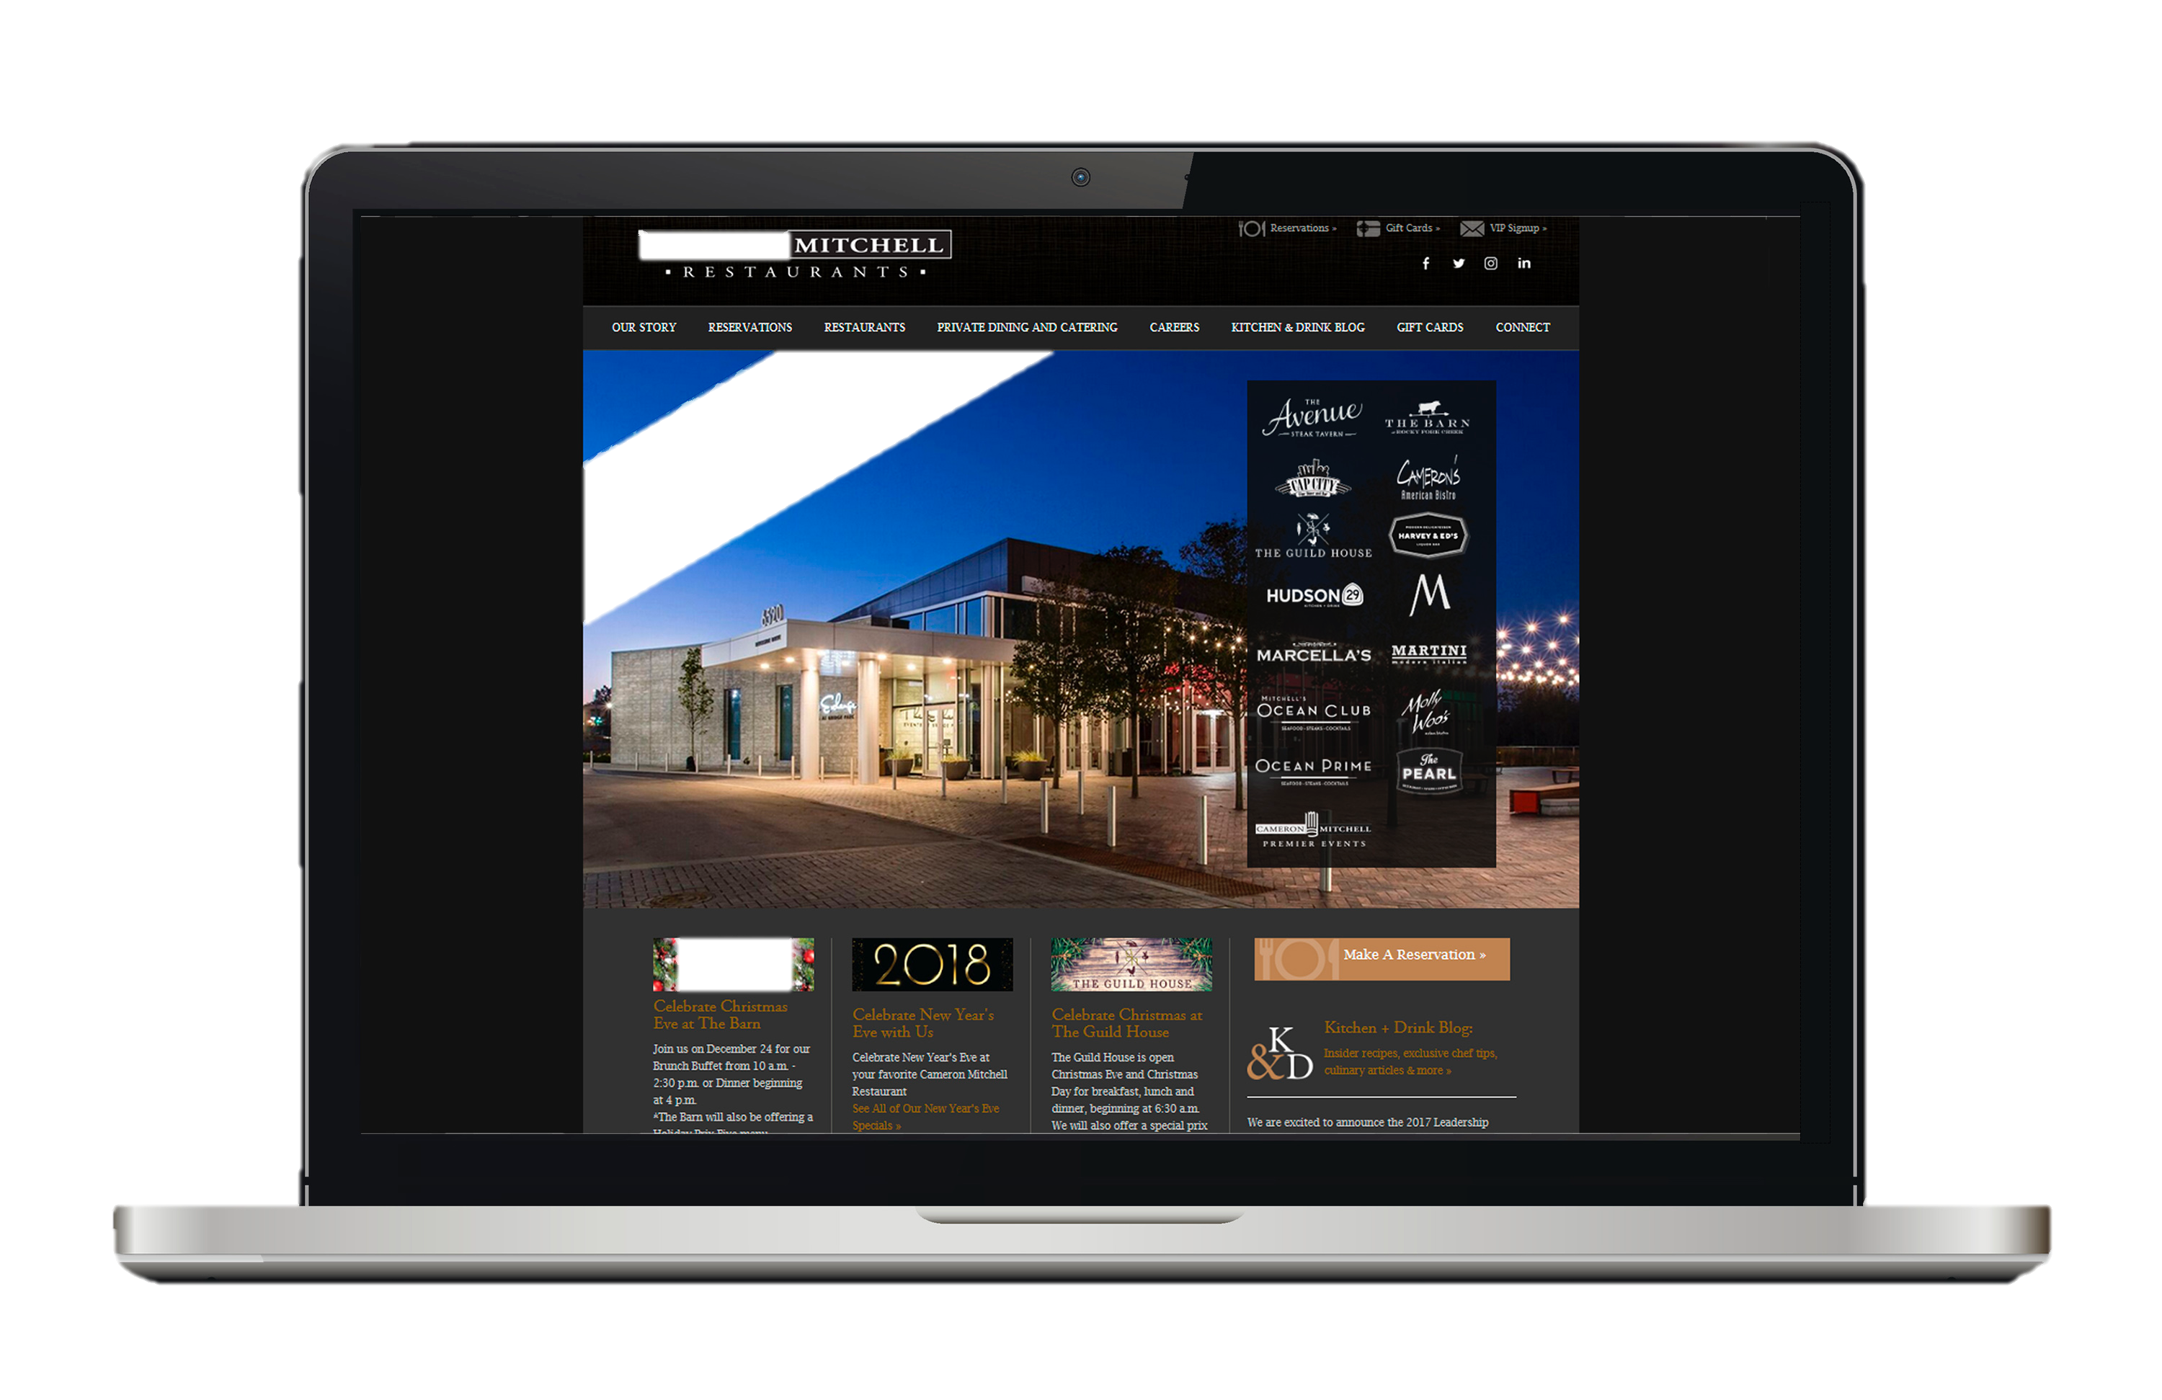
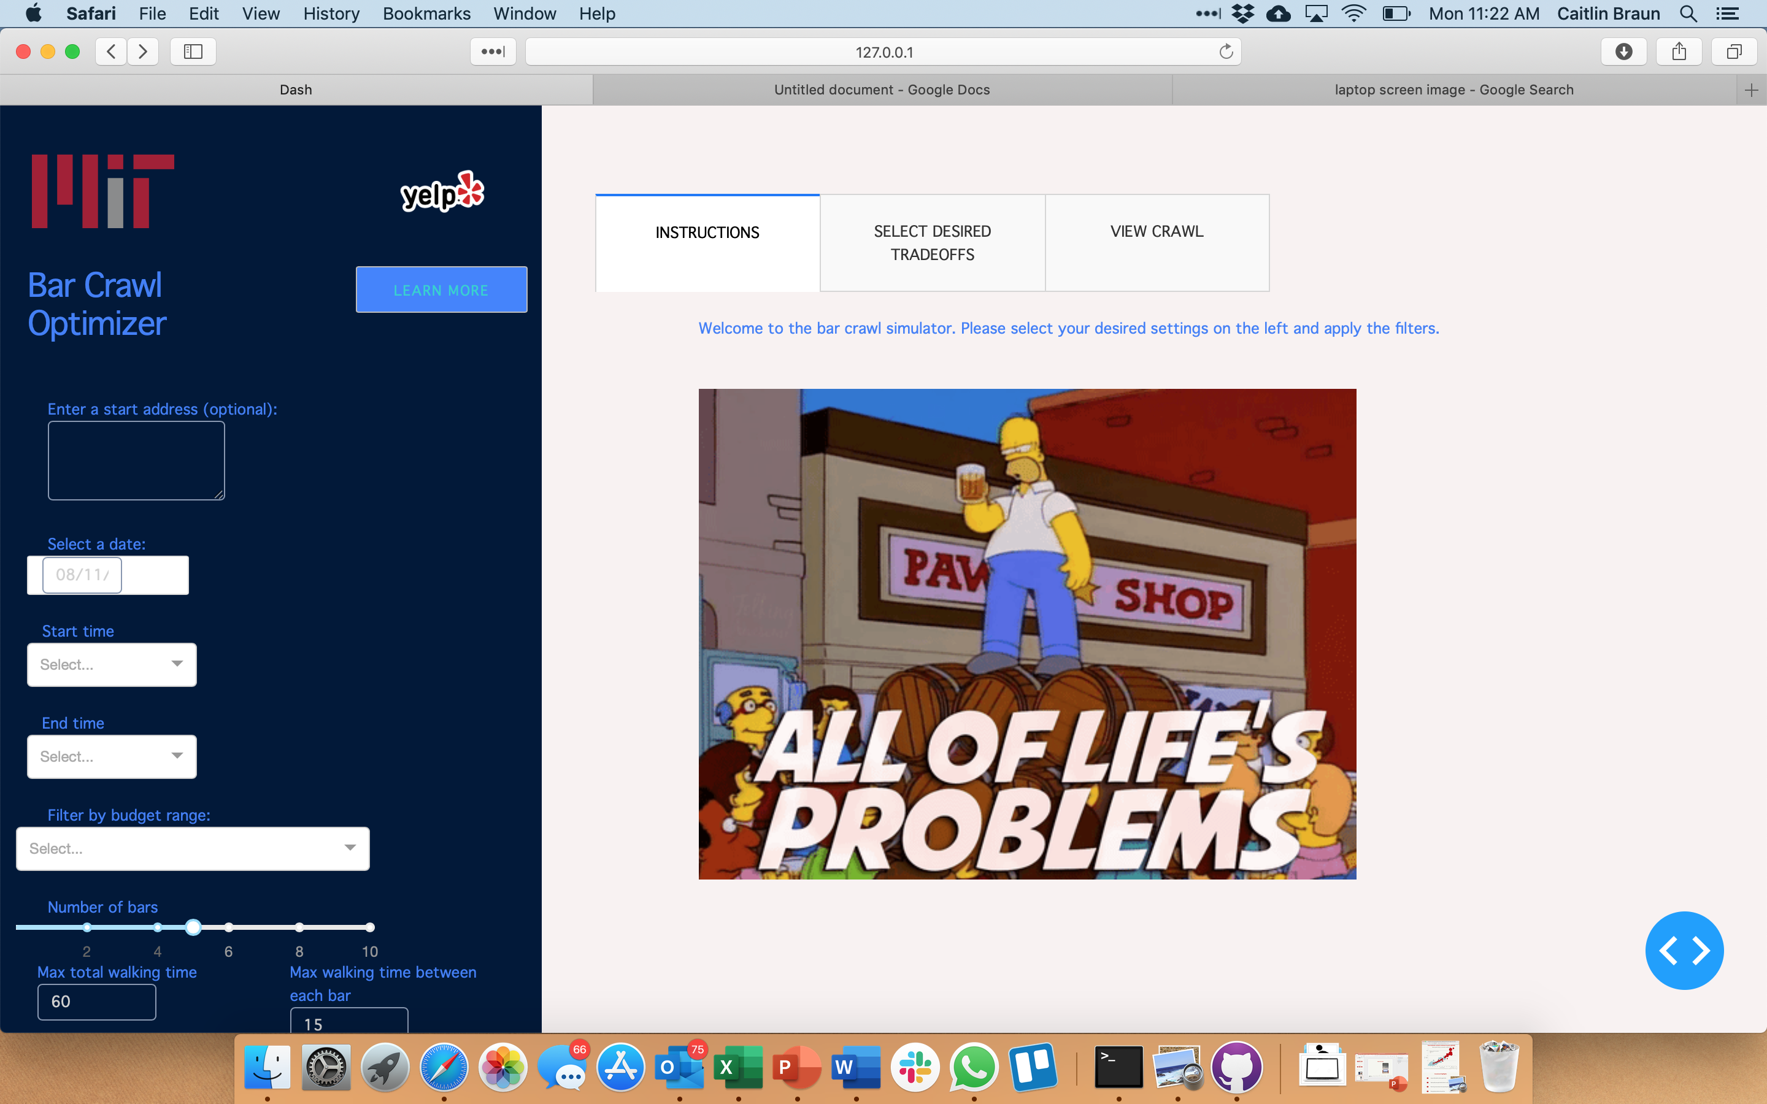
Demo
Notes:
Add hyperlink

Slide 8
Under the hood
A great user interface is often a good way to
hide a mediocre algorithm…
…not the
case here
Notes:
the problem we are tackling is incredibly challenging and we truly surpassed ourselves to solve it”

Slide 9
Constraints

Slide 10
Results

Slide 11
Additional Applications
Trip Planning with live load
Notes:
Amazon fresh
Harrys job
Target delivery
Tour services – go to all sites in one trip
LGO - dpt
Live load unload

Slide 12
Questions

